Slide 1
Decision Making in C
Presented By
M. Vishnu Priya, M.E Computer Science,
Assistant Professor.

Slide 2
Decision Making in C
(if , if..else, Nested if, if-else-if )
The conditional statements (also known as decision control structures)
such as if, if else, switch, etc. are used for decision-making purposes
in C programs.
They are also known as Decision-Making Statements and are used to
evaluate one or more conditions and make the decision whether to
execute a set of statements or not. These decision-making statements
in programming languages decide the direction of the flow of
program execution.

Slide 3
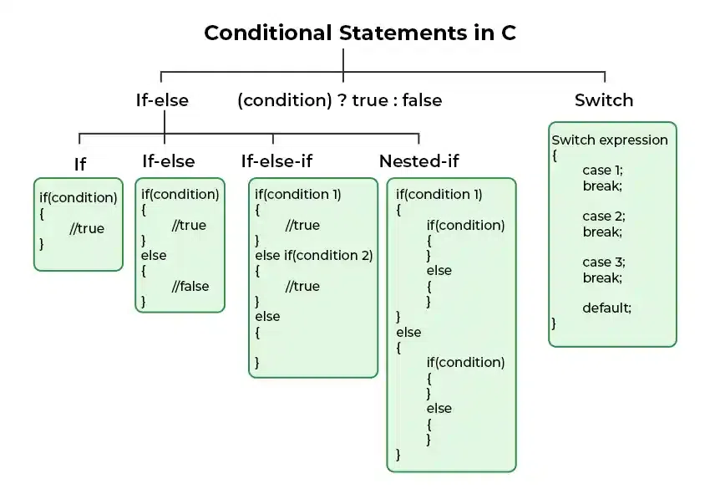
Types of Conditional Statements in C

Slide 4
Following are the decision-making statements available in C:
if Statement
if-else Statement
Nested if Statement
if-else-if Ladder
switch Statement

Slide 5
if in C
The if statement is the most simple decision-making statement. It is used to decide whether a certain
statement or block of statements will be executed or not i.e if a certain condition is true then a block
of statements is executed otherwise not.
Syntax of if Statement:
if(condition)
{
// Statements to execute if
// condition is true
}

Slide 6
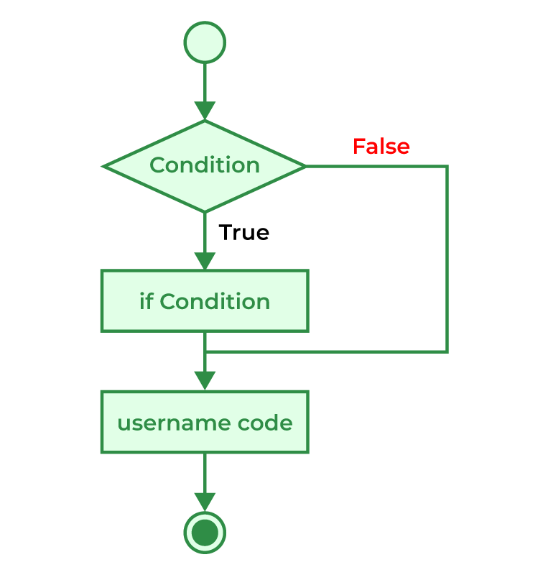
If Statement
#include <stdio.h>
int main() {
int a;
printf("Enter a number: ");
scanf("%d", &a);
if (a == 10) {
printf("a is equal to 10\n");
}
return 0;
}
Flowchart of if Statement

Slide 7
if-else in C
The if statement alone tells us that if a condition is true it will execute a block of statements and if the
condition is false it won’t. The if-else statement consists of two blocks,
one for false expression and one for true expression.
Syntax of if else in C
if (condition)
{
// Executes this block if
// condition is true
}
else
{
// Executes this block if
// condition is false
}

Slide 8
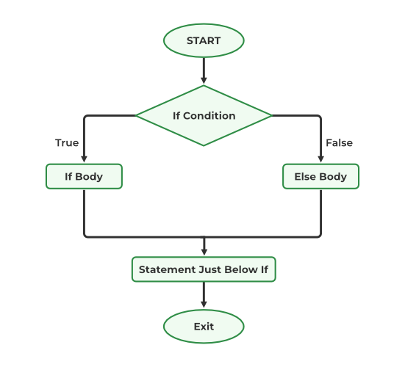
If-else Statement
#include <stdio.h>
int main() {
int a;
printf("Enter a number: ");
scanf("%d", &a);
if (a == 10) {
printf("a is equal to 10\n");
} else {
printf("a is not equal to 10\n");
}
return 0;
}
Flowchart of if-else Statement

Slide 9
Nested if-else in C
A nested if in C is an if statement that is the target of another if statement. Nested if statements mean an if
statement inside another if statement. Yes, C allow us to nested if statements within if statements,
i.e, we can place an if statement inside another if statement.

Slide 10
Syntax of Nested if-else
if (condition1)
{
// Executes when condition1 is true
if (condition_2)
{
// statement 1
}
else
{
// Statement 2
}
}
else {
if (condition_3)
{
// statement 3
}
else
{
// Statement 4
}
}

Slide 11
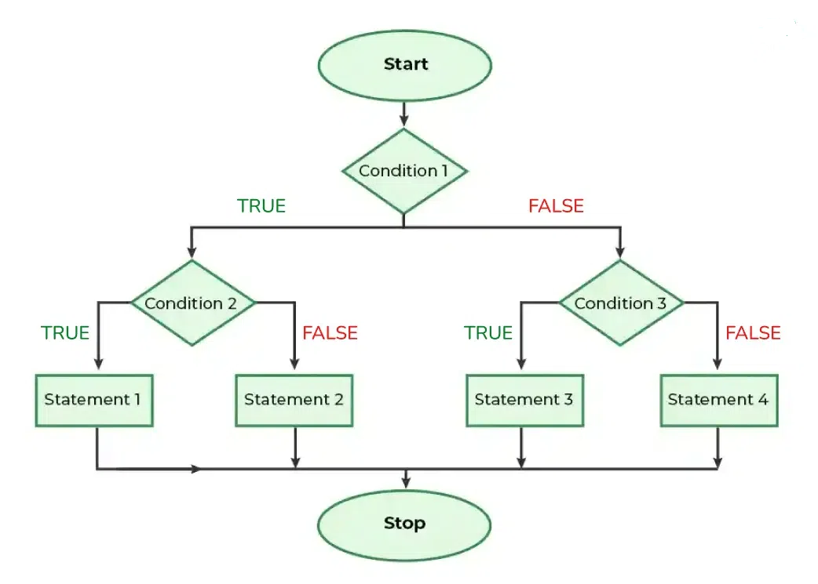
Flowchart of Nested if-else

Slide 12
Nested if Statement
#include <stdio.h>
int main() {
int a;
printf("Enter a number: ");
scanf("%d", &a);
if (a > 5) {
if (a == 10) {
printf("a is 10 and greater than 5\n");
} else {
printf("a is greater than 5 but not 10\n");
}
} else {
printf("a is 5 or less\n");
}
return 0;
}

Slide 13
if-else-if
The if else if statements are used when the user has to decide among multiple options.
The C if statements are executed from the top down. If none of the conditions is true, then the final else
statement will be executed. if-else-if ladder is similar to the switch statement.
Syntax of if-else-if
if (condition)
statement;
else if (condition)
statement;
.
.
else
statement;

Slide 14
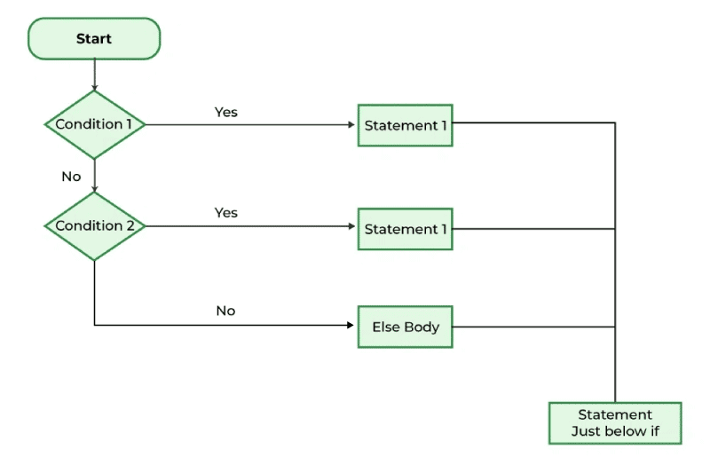
If-else-if
#include <stdio.h>
int main() {
int a;
printf("Enter a number: ");
scanf("%d", &a);
if (a > 10) {
printf("a is greater than 10\n");
} else if (a == 10) {
printf("a is equal to 10\n");
} else {
printf("a is less than 10\n");
}
return 0;
}
Flowchart of if-else-if

Slide 15
Switch Statement in C
The switch case statement is an alternative to the if else if ladder that can be used to execute the conditional
code based on the value of the variable specified in the switch statement.
The switch block consists of cases to be executed based on the value of the switch variable.
Syntax of switch
switch (expression) {
case value1:
statements;
case value2:
statements;
....
....
....
default:
statements;
}

Slide 16
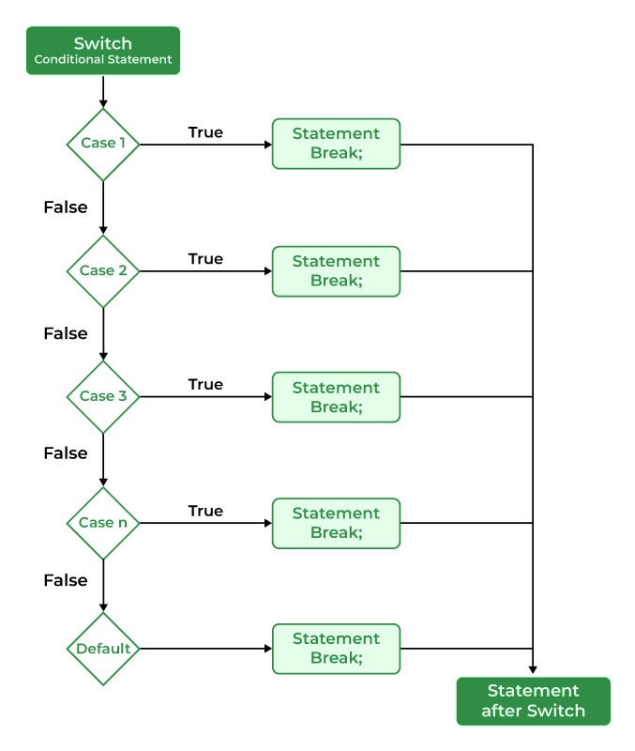
Switch Statement
#include <stdio.h>
int main() {
int a;
printf("Enter a number: ");
scanf("%d", &a);
switch (a) {
case 5:
printf("a is 5\n");
break;
case 10:
printf("a is 10\n");
break;
default:
printf("a is neither 5 nor 10\n");
}
return 0;
}
Flowchart of switch

Slide 17

Thank You

